Slide 1

Understanding Project Structure & Libraries in Dart

Slide 2


Why Structure Matters in Dart Projects
Maintainability
Well-organized projects are easier to understand, debug, and maintain over time, reducing technical debt.
Collaboration
A clear structure enables teams to work together efficiently, integrating changes seamlessly and minimizing conflicts.
Packages
Dart leverages packages as fundamental units for code sharing and reuse, fostering modular development.
API Clarity
Distinguishing between public APIs and internal code ensures clear, robust, and understandable interfaces.

Slide 3
Anatomy of a Dart Package: The Root Files
pubspec.yaml
pubspec.lock
The essential package manifest, defining its name, version, and critical dependencies.
Ensures consistent dependency versions, particularly for applications, by locking specific package versions.
README.md & CHANGELOG.md
LICENSE
Crucial for documentation, providing an overview and detailed version history for users and developers.
Specifies usage rights, often using OSI-approved licenses like BSD-3-Clause for clarity and broad adoption.

Slide 4





Core Directories in a Dart Package
lib/
bin/
Houses public libraries, with lib/<package_name>.dart as the usual main entry point.
Contains executable scripts (e.g., main.dart) for applications or command-line tools.
src/
test/
Within lib/, holds internal implementation files not intended for public exposure.
Dedicated to all unit and integration tests, ensuring code quality and functionality.
Optional directories like example/ for sample usage and doc/ for generated documentation enhance package usability.

Slide 5
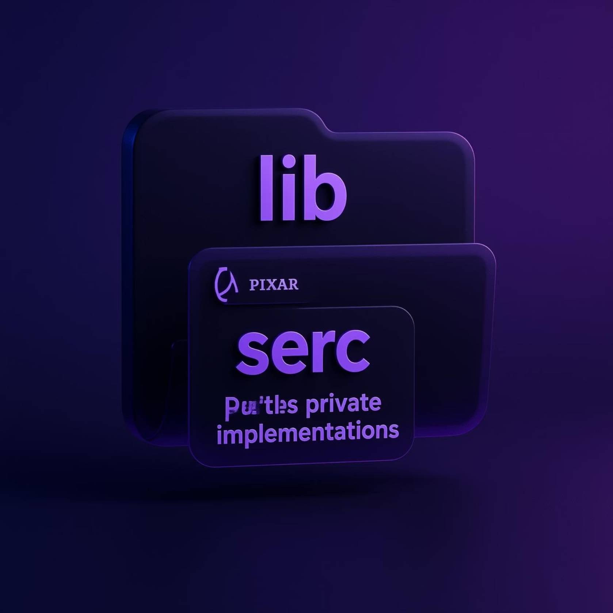
Public vs Internal Code: The lib and src Pattern
1
Public Accessibility
Only files directly within the lib/ directory are accessible to external package users.
2
Internal Encapsulation
Place all internal implementation code inside lib/src/ to effectively hide these details.
3
API Export
Export only the essential public API from your main lib/<package_name>.dart file.
4
Clean Interfaces
This pattern promotes strong encapsulation, leading to cleaner, more maintainable, and robust APIs.

Slide 6

Dart Libraries & Privacy Model
Every File is a Library
Underscore for Privacy
Library-Level Scope
In Dart, every single .dart file inherently acts as its own library, even without an explicit library directive.
Identifiers (variables, functions, classes) that begin with an underscore (_) are private to their containing library.
Dart's privacy model operates at the library level, meaning there are no traditional public, private, or protected keywords for classes or methods.
This unique approach allows for flexible modularity, enabling libraries to be split into multiple parts while maintaining a clear privacy boundary.

Slide 7
Importing Libraries: Schemes and Prefixes
Built-in SDK Libraries
Package Libraries
Utilize import 'dart:core'; to access Dart's foundational SDK libraries like dart:async or dart:math.
For packages, use import 'package:your_package/your_lib.dart'; to bring in external functionality.
Prefixes for Conflict Resolution
Selective Imports
Employ prefixes, such as import 'package:lib2/lib2.dart' as lib2;, to prevent name collisions between imported libraries.
Fine-tune your imports with show or hide keywords to precisely control which symbols are exposed in your namespace, enhancing clarity and reducing clutter.

Slide 8

Deferred (Lazy) Loading of Libraries
Reduce Startup Time
Load non-essential libraries only when they are needed, significantly speeding up application initialization.
Deferred Import Syntax
Use import 'package:lib/deferred_lib.dart' deferred as lib; to mark a library for lazy loading.
Explicit Loading Call
Invoke await lib.loadLibrary(); before accessing any code from the deferred library.
Ideal for Web Apps
Especially beneficial for large features or optional modules in web applications, optimizing resource usage.

Slide 9

Common Dart Libraries & Packages
Core SDK
Essential built-in libraries like dart:core, dart:async, dart:collection, and dart:math form the foundation of Dart programming.
pub.dev Packages
Access a vast ecosystem of popular packages (e.g., http, provider, path) managed through pub.dev, enhancing functionality.
Dependency Management
Declare and manage package dependencies and their versions efficiently using your pubspec.yaml file.
Accelerate Development
Leverage the rich collection of community packages to significantly speed up your development process and build robust applications.

Slide 10
Summary: Best Practices for Dart Project Structure
Follow Conventions
Adhere to Dart's package layout standards for maximum clarity and compatibility.
Clean Public API
Only expose necessary files in lib/ to maintain a clear and concise public interface.
Utilize Library Privacy
Employ the underscore (_) convention and the src/ directory to effectively hide internal implementations.
Manage Dependencies & Docs
Carefully maintain your pubspec.yaml and markdown files for dependencies and comprehensive documentation.
Strategic Imports
Employ imports and deferred loading thoughtfully for modular, efficient, and performant code architecture.

